Slide 1
Film Database
Michael Moua
Paul Kim

Slide 2
System Description
User implements a film’s data onto a table, filling out the information based on the provided format.
User has access to review keys for movie.
Option to update data aspects or delete rows.
Can use pre-determined options to print out data based on criteria.

Slide 3
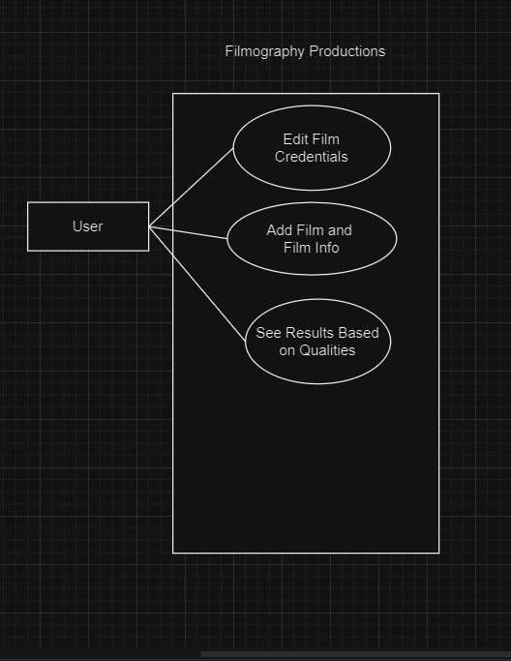
Use Case Diagram

Slide 4
Languages
Code implemented on Sqlite3, a programming language with formatting like the english language that is useful for building and dealing with tables.
Files managed through GitHub
Programming developed through Visual Studio Code, which is compatible with a variety of programming languages.
Interactivity built on Python.

Slide 5
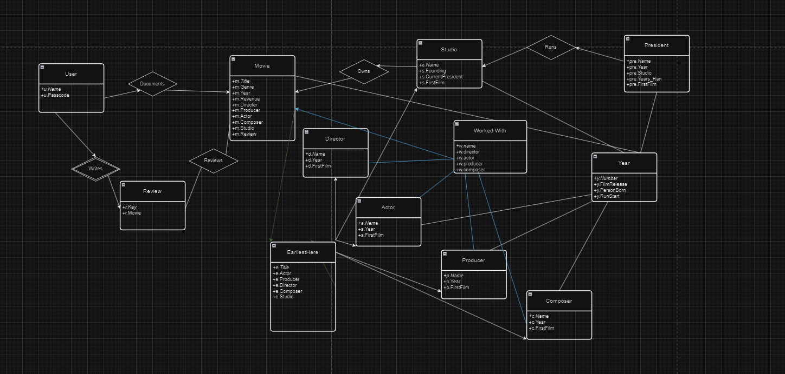
E/R Diagram And Schema

Slide 6
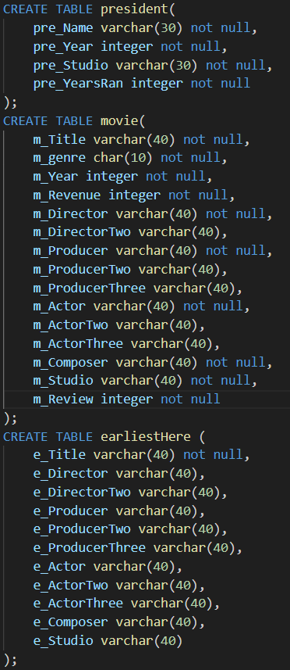
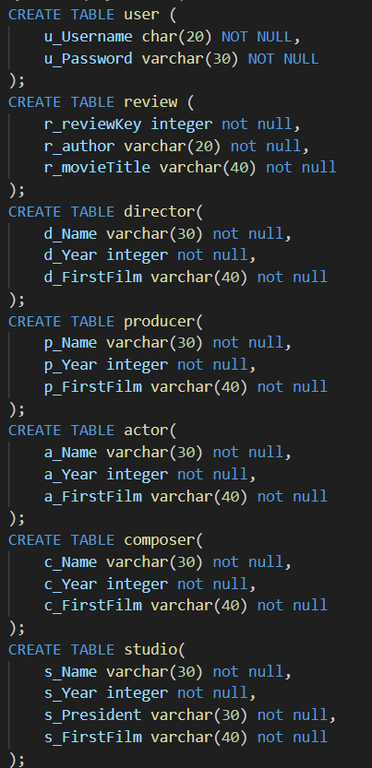
Relational Schema Expanded
User
u.Name, u.Passcode
Review
r.Key, r.Movie, r.User
Movie
m.Title, m.Genre, m.Year, m.Revenue, m.Director, m.Producer, m.Actor, m.Composer, m.Studio, m.Review

Slide 7
Relational Schema cnt.
Director
d.Name, d.Year, d.FirstFilm
Producer
p.Name, p.Year, p.FirstFilm
Actor
a.Name, a.Year, a.FirstFilm
Composer
c.Name, c.Year, d.FirstFilm

Slide 8
Relational Schema cnt.
Studio
s.Name, s.Founding, s.CurrentPresident, s.FirstFilm
President
pre.Name, pre.Year, pre.Studio, pre.Years_Ran

Slide 9
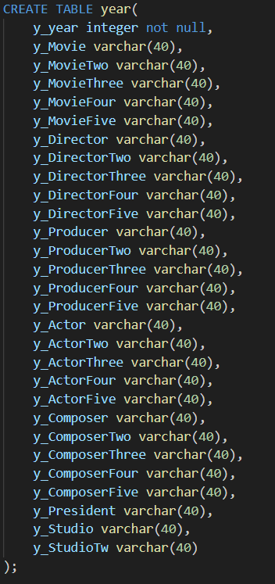
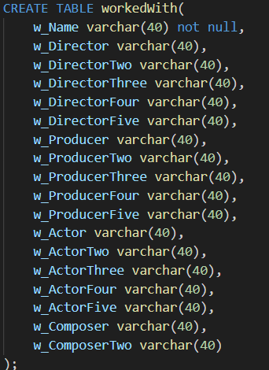
Many to Many
EarliestHere:
m.Title, d.name, p.name, a.name, c.name, s.name
FilmsWorkedOn:
m.Title, d.name, p.name, a.name, c.name
Year:
y.year, m.title, d.name, p.name, a.name, c.name, s.name, pre.name

Slide 10
Time to Demo

